Slide 1
CSE302: Computer Networks Project
Title:
Securing remote desktop app using RSA Encryption made with RDP protocol
in Java
Presented By
124003275: Sanjay Ram.G,
Guide Name: Dr. R. Kavitha, CSE/SoC, SASTRA University
Date of Presentation: 17.10.2022
1

Slide 2
Points to be discussed
Aim & Objective
Problem Statement
Existing Solution’s
Literature Survey
Work Flow Diagram
System Configuration : Software, Hardware, Network type, Protocols used
Work Done (Implementation code link)
Sample I/O (screen shot)
Proposed Work Flow and Methodology
References

Slide 3
AIM & OBJECTIVES
The aim of the project is implementing the RDP protocol in wireless Network to simulate the Remote Desktop Application, on Client-Server environment.
Objective 1: understanding RDP protocol and RSA encryption
Objective 2: applying RDP on top of tcp, udp network concepts
Objective 3: Creating java app
Objective 4: Benefits to the Enterprise users for secure
remote desktop connection.

Slide 4

Problem Statement & Solution : One line story
Problem statements are:
Less security in Data communication is identified
Secure application expected by the enterprise users
The Solutions are:
Required RSA encryption method is provided for the security of the app.

Slide 5
Existing Solutions- LITERATURE SURVEY
all security operations such as encryption and decryption, data integrity checks, and server authentication are implemented by one of the following External Security Protocols: TLS 1.0 ([RFC2246]) TLS 1.1 ([RFC4346]) TLS 1.2 ([RFC5246])
With these available solutions, we are adding an extra security for this
RDP protocol with RSA encryption.

Slide 6
System configuration
Client
Hardware used : CPU 1 GHz or faster processor & RAM 1024MB min.
Software used : Windows OS with Java
Network : wireless
Protocol : RDP
Server
Hardware used : CPU 1 GHz or faster processor & RAM 1024MB min.
Software used : Windows OS with Java
Network : wireless
Protocol : RDP

Slide 7
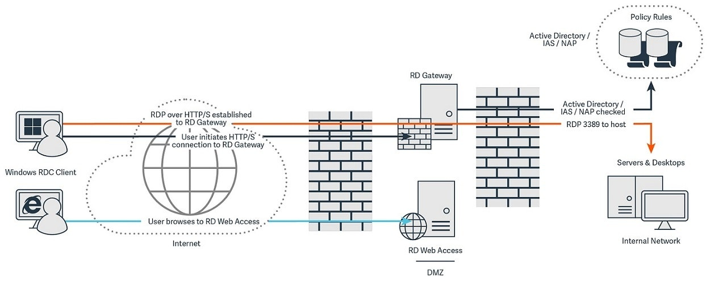
Network Architecture

Slide 8
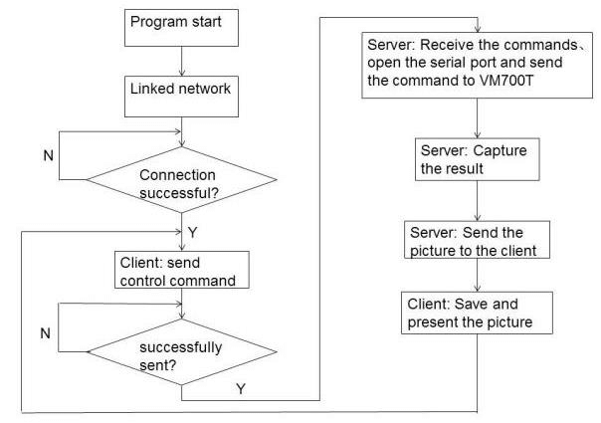
Working Flowchart : Remote Control System

Slide 9
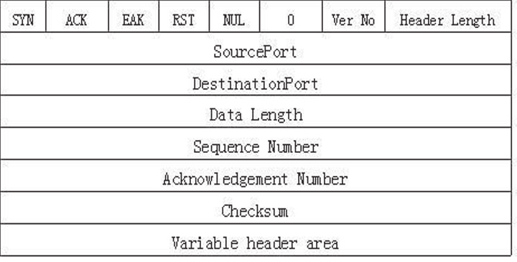
Proposed Protocol Description
RFC number : defined in RFC 908 and updated in RFC 1151
RDP format :

Slide 10
Network efficiency

Slide 11
Link for code :
https://drive.google.com/drive/folders/1wY_ZUr6lrAjC9tG7xLY7kEkxqcVkfOsS?usp=sharing

Slide 12
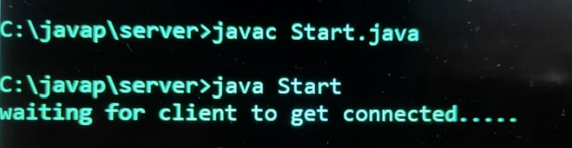
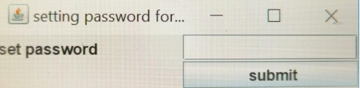
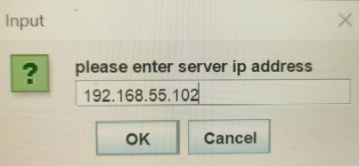
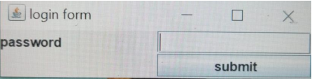
17
Server :
Client :

Slide 13
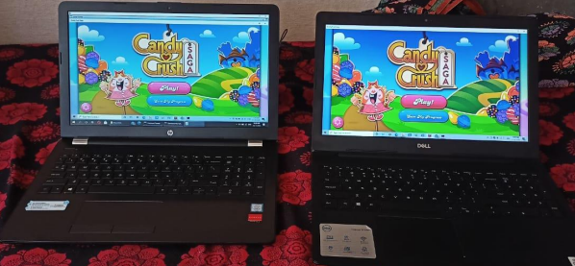
Output :

Slide 14
References
https://en.wikipedia.org/wiki/Remote_Desktop_Protocol
https://www.parallels.com/blogs/ras/rdp-meaning/
https://en.wikipedia.org/wiki/File_Transfer_Protocol#:~:text=The%20File%20Transfer%20Protocol% 20(FTP,the%20client%20and%20the%20server.
https://www.geeksforgeeks.org/file-transfer-protocol-ftp-in-application-layer/
https://www.javatpoint.com/computer-network-ftp
https://computingforgeeks.com/how-to-enable-remote-desktop-protocol-rdp-on-windows-server-2019/
https://searchenterprisedesktop.techtarget.com/definition/Remote-Desktop-Protocol-RDP 8. https://www.howtogeek.com/175087/how-to-enable-and-secure-remote-desktop-on-windows

Slide 15
Thank You

